Slide 1
ROS2 Basic Training

Slide 2
Objectives
Provide a working knowledge of basic ROS2 concepts
Provide a high level understanding of ROS2 concepts which can be further developed in the future
Provide practical ROS2 exercises to get new users acquainted with applying basic concepts

Slide 3
Linux Refresher – Command line tools
pwd – Check your absolute filepath
ls – Show list of files in the current directory
cd – go to a particular directory
mkdir – create a folder or directory
rm -r : Delete a folder and files it contains
cp <src> <dest> : Copies <src> to <dest>
mv <src> <dest> : Moves/renames <src> to <dest>
kill <pid> : Kills program with process id <pid>
clear : clears the terminal

Slide 4
Linux Refresher
Use Ctrl + Shift + T to open a new terminal
Use the Tab key to auto complete a command, or to list the possible arguments for the command
Stop a process using Ctrl + C
Force stop a process using Ctrl+Z

Slide 5
Overview
What is ROS?
ROS2 Middleware
ROS2 Unified API
Computation graph

Slide 6
What is ROS?
A meta-operating system that provides similar services to typical Operating systems
Hardware abstraction
Software gaining access to hardware through program interfaces
Low level device control
Message passing between process
Package management
...Much more!
A framework built on top of an existing operating system
Linux for ROS1
Linux, Windows and OS for ROS2
© 2021 Advanced Remanufacturing and Technology Centre / ROS-Industrial Consortium Asia Pacific

Slide 7
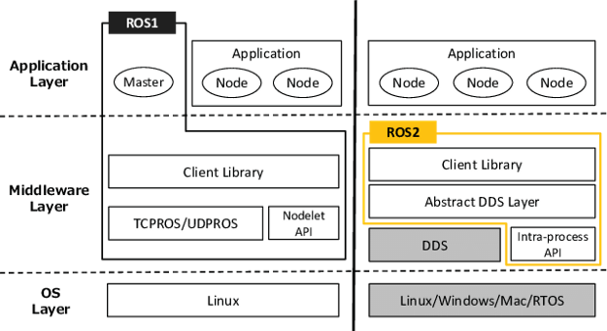
ROS1 vs ROS2 Middleware
ROS1 uses custom communication protocols built for the system
TCPROS
UDPROS
ROS2 Leverages on the DDS communication protocol to determine message transfer
Notes:
https://etienne-schmitz.medium.com/comment-jai-appris-ros-1-b55836b94a74

Slide 8
DDS (Data Distributed service)
Middleware framework standard for high performance, dependable, real time data exchange (DDS itself is not code!)
Defines ROS2's publish-subscribe model
This standard has been used in many mission critical applications
Battleships
Financial Systems
Space Systems
Flight Systems
...etc
DDS can be implemented by different vendors with slightly different APIs
FastRTPS (eProsima)
Connext DDS (RTI)
Notes:
https://etienne-schmitz.medium.com/comment-jai-appris-ros-1-b55836b94a74

Slide 9
DDS on ROS2
ROS2 is designed to be DDS implementation agnostic through a middleware interface
No differences between different vendor implementation!
User
ROS Client Library
Libraries that makes ROS accessible to the user by code
Middleware interface
Generic middleware interface
DDS adapter 1
DDS adapter 2
DDS adapter 3
DDS Implementation 1
DDS Implementation 2
DDS Implementation 3
Thin adapter (Maps the API of the specific implementation to the general middleware)
Notes:
https://etienne-schmitz.medium.com/comment-jai-appris-ros-1-b55836b94a74

Slide 10
ROS2 – Unified API
ROS1 Client libraries
roscpp (C++)
rospy (Python)
APIs Developed independently
Different features in each library
Notes:
https://www.researchgate.net/figure/ROS-graph-concepts-a-Core-computation-graph-level-b-messages-publish-and-subscribe_fig2_323709086

Slide 11
ROS2 – Unified API
ROS2 Client libraries
APIs are built on top of a common core client library
Ensures that any changes made to functionalities are reflected in all derived client libraries
rclcpp (C++)
rclpy (Python)
rcl (C)
Notes:
https://roboticsbackend.com/ros1-vs-ros2-practical-overview/#The_ROS_API_-_rclcpp_rclpy

Slide 12
General ROS2 Structure
Workspace
Package
Package
Package
Node
Node
Node
Node
Node
Node
Node
Node
Node
Node
Node
Node
Notes:
https://roboticsbackend.com/ros1-vs-ros2-practical-overview/#The_ROS_API_-_rclcpp_rclpy

Slide 13
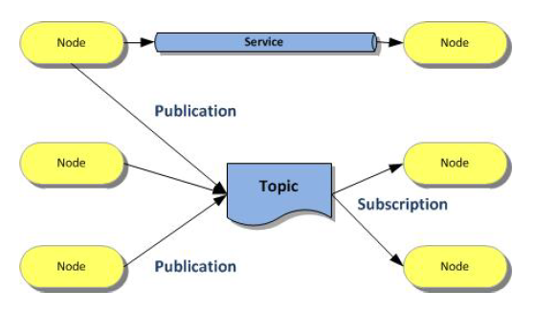
Computation Graph
Displays the peer to peer network of ROS processes that process data together
Reflects the communication in a ROS2 system
Participants of the graph are called Nodes
Nodes can typically
Publish (provide) data
Subscribe (read) data

Slide 14
Activity 0 - Configuring ROS 2 environment
You will need to run this command on every new shell you open to have access to the ROS 2 commands.
source /opt/ros/foxy/setup.bash
Sourcing ROS 2 setup files will set several environment variables necessary for operating ROS 2. If you ever have problems finding or using your ROS 2 packages, make sure that your environment is properly setup using the following command:
printenv | grep -i ROS
Check that variables like ROS_DISTRO and ROS_VERSION are set. For example, if you’re using Foxy, you would see:
ROS_VERSION=2
ROS_PYTHON_VERSION=3
ROS_DISTRO=foxy

Slide 15
ROS2 Filesystem

Slide 16
ROS2 Packages
The software in ROS2 is organized into packages
The smallest build part in ROS2 Dedicated to one functionality,
Hardware driver
Algorithm
Visualization tool
Library ...
Packages can be grouped to metapackages (e.g navigation2)
References one or more related packages
Only contain execution dependencies beneficial for release and version control

Slide 17
ROS2 Package installation (Debian)
Automatic method of installation
Usually used for Stable versions
Contains prebuilt binaries (Compiled code that can be installed)
sudo apt install ros-<distro>-package-name
Example:
sudo apt install ros-foxy-nav2-core

Slide 18
ROS2 Setup scripts (ROS2 setup file)
ROS2 Installation setup scripts
Generated during the Debian installation of ROS2
For each new terminal, you need to source the setup files before using ROS2
source /opt/ros/<distro>/setup.bash
source /opt/ros/foxy/setup.bash
For ROS2 Foxy
TAKE NOTE!!!
Without sourcing the ROS2 setup files, you won’t be able to access ROS 2 commands, or find or use ROS 2 packages. In other words, you won’t be able to use ROS 2.

Slide 19
Why Source?
Sourcing a file makes the changes of the file applicable in the current shell (The terminal is a program that runs in the shell) which we are working in.
Usually, when we execute a command or a script, a new sub-shell is created and the script is executed in the sub-shell.
If the script or the command intends to make any change to the current shell, it will not happen.
In order to make the changes applicable in the current shell itself, we "source" the file.

Slide 20
Packages in the Command Line
Package discovery
ros2 pkg list
List out all available packages
ros2 pkg list | grep <filter_text>
List out all available packages satisfying the required filter
ros2 pkg executables <package_name>
List out available node executables names within a package
Running Nodes
ros2 run <package_name> <node_name>

Slide 21
Activity 1: Getting started with TurtleSim!
Understand how to install a Debian ROS2 package
Discover the list of possible executables within a package.
Running a ROS2 package
Getting acquainted with turtlesim

Slide 22
ROS2 Package installation (Source)
Manual Compilation
“Latest Code”
Allows for code adjustments
Download from source (usually git):
Do it in your source space (e.g. ~/devel_ws/src):
Install all dependencies of package(s)
rosdep : download and install dependencies required by ROS packages.
$ git clone <github_link>
$ rosdep install --from-paths src --ignore-src --rosdistro foxy -y

Slide 23
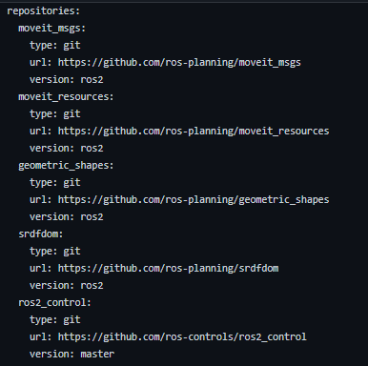
ROS2 Package installation (Source)
Manage multiple version-control packages: vcstool
A version control system (VCS) tool
A command-line tool to make working with multiple repositories easier.
moveit2.repos
For example: in your workspace(e.g. ~/devel_ws):
$ wget https://raw.githubusercontent.com/ROBOTIS-GIT/turtlebot3/foxy-devel/turtlebot3.repos
$ vcs import src < turtlebot3.repos

Slide 24
Packages Creation
Change this to ament_cmake for cmake packages!
Basic Package Creation
ros2 pkg create --build-type ament_python <package_name>
Package Creation with Node name
ros2 pkg create --build-type ament_python --node-name <node_name> <package_name>
Package Creation with added dependencies
ros2 pkg create --build-type ament_python --dependencies [deps]

Slide 25
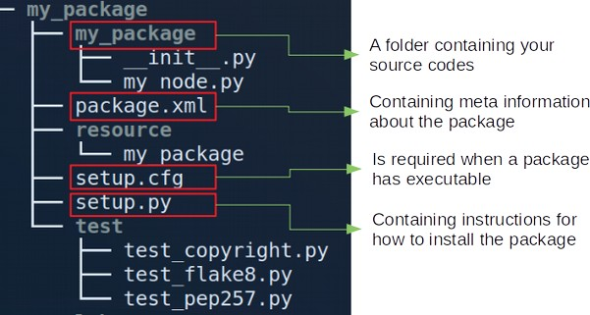
ROS2 Package Structure (Python)
Files:
setup.cfg: Tell setuptools to put your executables in lib
setup.py: The build script for setuptools

Slide 26
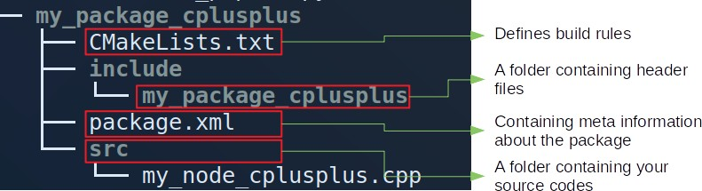
ROS2 Package Structure (CMake)

Slide 27
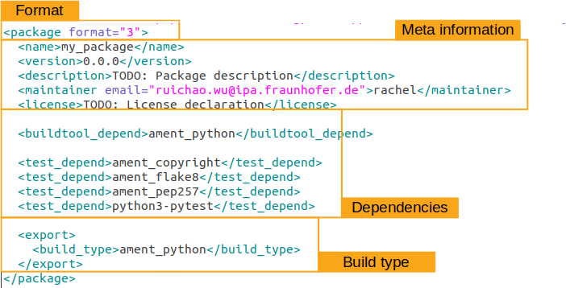
Package.xml

Slide 28
Package.xml
Dependencies
Dependencies can be Other ROS packages and System libraries (e.g. Boost) Dependencies:
<buildtool_depend>: Declares a ROS package for a tool that is executed during the build process
<exec_depend>: Declares a ROS package that this package needs at execution-time
<build_depend>: Declares a ROS package that this package requires at build-time.
<test_depend> : Declares a ROS package that your package needs for running its unit tests
<build_export_depend> : Declares a ROS package that this package needs as part of some build interface it exports.
<depend> : All-in-one (<build_depend>, <build_export_depend> and <exec_depend>)

Slide 29
Linting tools
Basic form of static analysis of packages
Helps to automatically check for
Programmatic errors
Stylistic errors according to standard compliance
Add the following to package.xml of the package
<test_depend>ament_copyright</test_depend>
<test_depend>ament_flake8</test_depend>
<test_depend>ament_pep257</test_depend>
For Python packages
Add the following to package.xml of the package
<test_depend>ament_lint_auto</test_depend>
<test_depend>ament_lint_common</test_depend>
For CMake packages
ament_lint_common: ament_clang_format, ament_clang_tidy, ament_cmake_clang_format, ament_cmake_clang_tidy
Package that contains commonly used linters

Slide 30
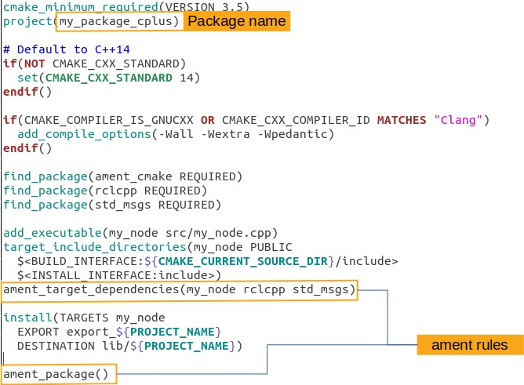
CMakeLists.txt (CMake)
Find and load external packages
Declare compilation for executables
Specify directories to use when compiling target executable

Slide 31
Setup.py (Python)
setup(
name=package_name,
version='0.0.0',
packages=[package_name],
data_files=[
('share/ament_index/resource_index/packages',
['resource/' + package_name]),
('share/' + package_name, ['package.xml']),
],
install_requires=['setuptools'],
author=‘_______',
author_email='________________’,
description='A package containing scripts for demos',
license='Apache License Version 2.0’,
install_requires=[‘package_1', ‘package_2', ' package_3'],
tests_require=['pytest'],
entry_points={
'console_scripts': [
‘node_name = package_name.script_name:main’,
],
},
)
Cmakelists.txt “Equivalent” for python packages
Installing relevant files from the package
Package that manages python packages
Package dependencies
Creates the required node from python script

Slide 32
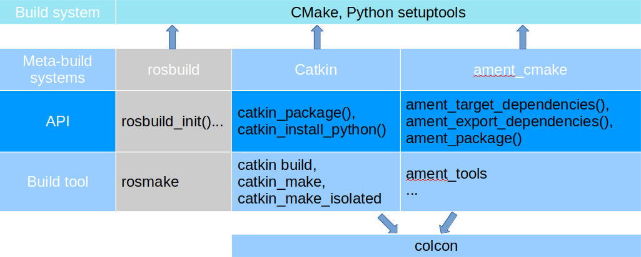
Colcon
Serves as a universal build tool
Builds a set of packages with a single invocation
Works with both ROS1 (catkin) and ROS2 (ament) packages
Helpful documentation: https://colcon.readthedocs.io/en/released/user/quick-start.html

Slide 33
Building and running packages
Installing dependencies
Installs required dependencies for packages in workspace
rosdep install --from-paths src --ignore-src --rosdistro foxy -y
Building packages
colcon build
Builds all packages in the workspace
colcon build --packages-select <package_name>
Builds selected packages
colcon build --symlink-install
Allows installed files to be changed for python scripts (No need to rebuild)

Slide 34


ROS2 Workspaces
A directory containing ROS 2 packages with a particular structure
Colcon creates build/ install/ log/ automatically as peers of the src/
Colcon build at this level
workspace
Not the same!
Contains packages
Contains source files
src
build
install
log
src
Package folders
Launch
ROS2
package 1
ROS2
package 2
ROS2
package 3
config
CMakeLists.txt
Package.xml
Setup.py
Package.xml
CMakeLists.txt
Package.xml
Notes:
https://www.uline.com/Product/Detail/S-19528/Folders/File-Folders-Letter-Manila

Slide 35
ROS2 Workspaces
Source Space (src/):
Contains the source version of packages
Build Space (build/):
Where intermediate files are stored
Install Space (install/):
Where each package will be installed to
Log Space (log/):
Contains various logging information about each colcon invocation

Slide 36
ROS2 Setup scripts (Workspace setup file)
Workspace installation setup scripts
Generated during the installation of your packages. (When you invoke build tool e.g colcon build)
For each new terminal, you need to source the setup file before running your packages in the workspace
$ source <workspace_path>/install/setup.bash
TAKE NOTE!!!
Without sourcing the workspace setup files, you won’t be able to access, find or use any of your packages in your workspace.

Slide 37
Exercise Time
Remember to source your ROS distro in every new terminal!
Create a workspace named dev_ws
Create a ros2 package within the src folder of the workspace
It should be a python package
It should have a package name my_package
It should contain a node my_node
Build the package
Source the workspace
Run the node executable my_node
Refer to the previous slides and the cheat sheet for clues!
Expected output:
hello world my_package package

Slide 38
Exercise Time - Solutions
source /opt/ros/foxy/setup.bash
Source ROS2 version
mkdir –p ~/dev_ws/src
Make the workspace directory with an src folder
cd ~/dev_ws/src
Navigate into the src folder
ros2 pkg create --build-type ament_python --node-name my_node my_package
Make the node
cd ~/dev_ws
Navigate to the workspace root directory
colcon build
Build the workspace
source install/setup.bash
Source the setup file for the workspace
ros2 run my_package my_node
Run the node from the package created

Slide 39
Ros2 nodes

Slide 40
Overview
Nodes
Inter/Intra Process communication
Topics Services Actions
Executor
Parameters
© 2021 Advanced Remanufacturing and Technology Centre / ROS-Industrial Consortium Asia Pacific

Slide 41
What is a node?
An element that serves a single, modular purpose in a robotics system
Controlling wheel motors
Controlling laser range-finder
Controlling a perception system
ROS2 Client libraries
rclcpp: Binaries of C++ files
rclpy: Python Scripts
Running a single node:
ros2 run <package_name> <executable_name> [arguments]
© 2021 Advanced Remanufacturing and Technology Centre / ROS-Industrial Consortium Asia Pacific

Slide 42
ROS1 vs ROS2 Node structure
?
© 2021 Advanced Remanufacturing and Technology Centre / ROS-Industrial Consortium Asia Pacific

Slide 43
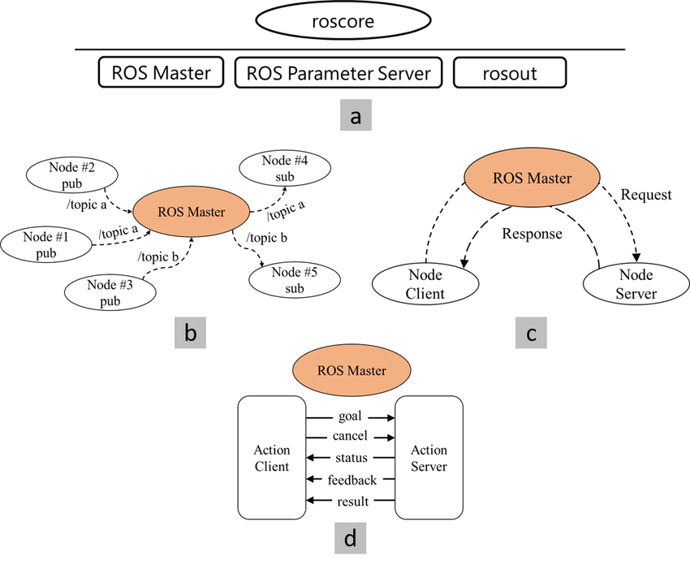
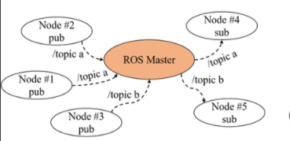
Automatic Discovery
ROS1 Node communication
Central point of failure!
Master Node tracks publishers, subscribers, node discovery, etc
© 2021 Advanced Remanufacturing and Technology Centre / ROS-Industrial Consortium Asia Pacific
Notes:
https://www.researchgate.net/figure/ROS-graph-concepts-a-Core-computation-graph-level-b-messages-publish-and-subscribe_fig2_323709086

Slide 44
Automatic Discovery
ROS2 Node communication
No central point of failure!
Node A
ROS_DOMAIN_ID = 2
Node A
ROS_DOMAIN_ID = 1
Node advertises its presence on a hidden topic
Node C
ROS_DOMAIN_ID = 1
Node B
ROS_DOMAIN_ID = 1
New Node created
© 2021 Advanced Remanufacturing and Technology Centre / ROS-Industrial Consortium Asia Pacific
Notes:
ROS2 (and more precisely DDS) uses UDP multicast to communicate the metadata allowing different node to discover each other and establish communication. Additionaly DDS allows you to
If your two machines are on the same network and your network configuration

Slide 45
Automatic Discovery
ROS2 Node communication
ROS2 specifies a domain ID (ROS_DOMAIN_ID) that is a logical barrier to segregate networks.
Machines with different domain IDs will not talk, nor interfere, with each other.​
Node A
ROS_DOMAIN_ID = 2
Node A
ROS_DOMAIN_ID = 1
Node C
ROS_DOMAIN_ID = 1
Node discovers other nodes
Node B
ROS_DOMAIN_ID = 1
© 2021 Advanced Remanufacturing and Technology Centre / ROS-Industrial Consortium Asia Pacific
Notes:
ROS2 (and more precisely DDS) uses UDP multicast to communicate the metadata allowing different node to discover each other and establish communication. Additionaly DDS allows you to
If your two machines are on the same network and your network configuration
The domain ID is used to segment the network in order to avoid interference between different groups of computers running ROS 2 on the same local area network. Machines with different domain IDs will not talk, nor interfere, with each other.

Slide 46
Activity 1.2: Configure your ROS Domain!
*input your_domain_id as the one given on the table
To maintain this setting between shell sessions, you can add the command to your shell startup script:
The ROS 2 development environment needs to be correctly configured before use. This can be done in two ways: either sourcing the setup files in every new shell you open, or adding the source command to your startup script.
​export ROS_DOMAIN_ID=<your_domain_id>​
echo "export ROS_DOMAIN_ID=<your_domain_id>" >> ~/.bashrc​
Notes:
https://docs.ros.org/en/foxy/Concepts/About-Composition.html

Slide 47
Node Composition
Aggregation of nodes in a single process
Simplifies code reuse
Nodelet style node creation standard makes process layout a deploy-time decision
Running multiple nodes in separate processes (Inter process)
Running multiple nodes in a single process (Intra-process)
Process fault isolation
Easy debugging
Lower overhead
More efficient communication
Notes:
https://docs.ros.org/en/foxy/Concepts/About-Composition.html

Slide 48
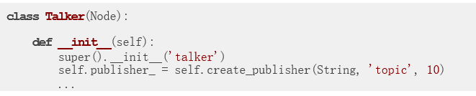
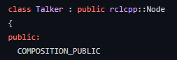
Node Composition
Writing a node as a component
Inherits from the Node class
Allows to be imported and used by other scripts
Able to create publishers, subscribers, servers, and clients within the node
Notes:
https://docs.ros.org/en/foxy/Concepts/About-Composition.html

Slide 49
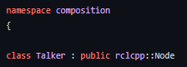
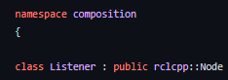
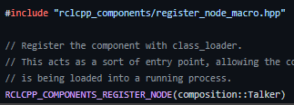
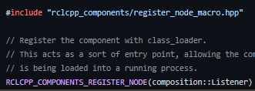
Node Composition
Registering a node as a component
Node: composition::Talker
Node: composition::Listener
Register the component with class_loader.
This acts as a sort of entry point, allowing the component to be discoverable when its library is being loaded into a running process
Notes:
https://docs.ros.org/en/foxy/Concepts/About-Composition.html
Using ROS2 Service APIs
Service calls
Command line tools
Launch files
Manual compositions
Running Standalone Executables
Component Manager is part of a ROS2 package that provides tools to manage dynamically loadable components.

Slide 50
Node Composition
Deploying components in a Launch File
container = ComposableNodeContainer(
node_name=<node_name>
node_namespace=‘’,
package=‘rclcpp_components’
node_executable=‘component_container’
composable_node_descriptions=[
ComposableNode(
package=<package_name>,
node_plugin=<plugin_name>,
node_name=<node_name>),
ComposableNode(
package=<package_name>,
node_plugin=<plugin_name>,
node_name=<node_name>)
],
output=‘screen’,
)
Official ROS2 Client Package containing tools for dynamically loadable components.
Relevant Node executable for the rclcpp package
Package containing your composable node
Name of the node plugin declared
Notes:
https://docs.ros.org/en/foxy/Concepts/About-Composition.html
Using ROS2 Service APIs
Service calls
Command line tools
Launch files
Manual compositions
Running Standalone Executables
Component Manager is part of a ROS2 package that provides tools to manage dynamically loadable components.

Slide 51
Node Composition
Deploying components in command line
Initialize the component container
ros2 run rclcpp_components component_container
ros2 component load /ComponentManager composition composition::Talker
ros2 component load /ComponentManager composition composition::Listener
Load the different composition using the ROS2 Component Manager
Notes:
https://docs.ros.org/en/foxy/Concepts/About-Composition.html
Using ROS2 Service APIs
Service calls
Command line tools
Launch files
Manual compositions
Running Standalone Executables
Component Manager is part of a ROS2 package that provides tools to manage dynamically loadable components.

Slide 52
Activity 2: Understanding ROS2 Nodes
Learn how to discover all running nodes in a ROS2 system
Learn how to remap ROS2 node properties
Learn how to find out more information about particular nodes
Useful Command line tools
ros2 node list
To look at what nodes are currently running:
ros2 node info <node_name>
To see more info about a node

Slide 53
ROS2 Publisher/Subscriber
Core method of message communication between nodes
Publisher -> Talker
Listener -> Subscriber
Each node can contain multiple subscribers and publishers!
Node 1
Topic
Node 2
Publisher_1
Subscriber_2
Message
Notes:
https://www.vectorstock.com/royalty-free-vector/group-chat-vector-3869402

Slide 54
Creating a publisher and subscriber in ROS2
Subscriber
rclcpp::Subscription<std_msgs::msg::String>::SharedPtr subscription;
subscription = this->create_subscription<std_msgs::msg::String>(
"topic",
10,
std::bind(&MinimalSubscriber::topic_callback, this, _1));
Callbacks
Message Type
Message queue size
Publisher
Topic name
rclcpp::Publisher<std_msgs::msg::String>::SharedPtr publisher;
publisher = this->create_publisher<std_msgs::msg::String>("topic", 10);
Notes:
The queue_size is important because messages are published asynchronously (by default) and are therefore sent to a queue to be processed, first in first out. Without this value being set, synchronous publishing is forced (but not recommended).

Slide 55
Creating a publisher and subscriber in ROS2 (Python)
Subscriber
self.subscription = self.create_subscription(
String,
'topic',
self.listener_callback,
10)
Callbacks
Message Type
Message queue size
Publisher
Topic name
self.publisher_ = self.create_publisher(String, 'topic', 10)
Notes:
The queue_size is important because messages are published asynchronously (by default) and are therefore sent to a queue to be processed, first in first out. Without this value being set, synchronous publishing is forced (but not recommended).

Slide 56
Publisher on CLI
To spawn a publisher over /topic with a rate of 10 Hz:
ros2 topic pub -r10 /topic std_msgs/msg/String "data: "Hello""
Publish rate
Topic
Name
Message
type
Field
name
Field
value

Slide 57
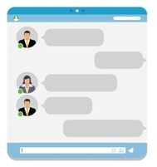
ROS2 Topics
Asynchronous communication
Sending messages without expecting an immediate response
Multiple concurrent publishers and subscribers for one topic
A single node can publish and subscribe to multiple topics
Every topic has a dedicated message type
Works like a chat room! Messages are not to any specific recipient
Notes:
https://www.vectorstock.com/royalty-free-vector/group-chat-vector-3869402

Slide 58
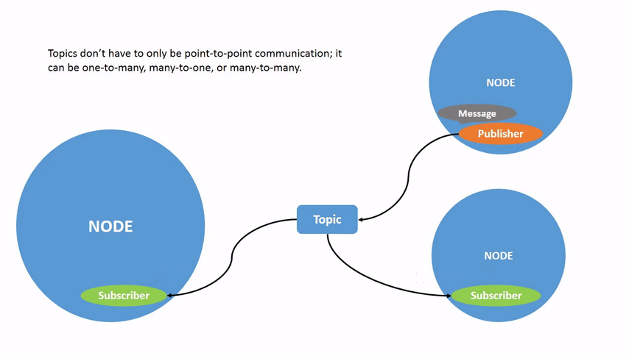
ROS2 Topics
Notes:
https://www.vectorstock.com/royalty-free-vector/group-chat-vector-3869402

Slide 59
ROS2 Topic on command line
ros2 topic list
List all topics currently subscribed to and/or publishing
ros2 topic type <topic>
Show the message type of the topic
ros2 topic info <topic>
Show topic message type, subscribers, publishers, etc.
ros2 topic echo <topic>
Echo messages published to the topic to the terminal
ros2 topic find <message_type>
Find topics of the given message type

Slide 60
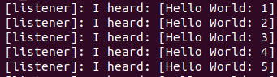
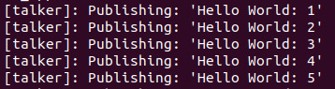
Seeing a publisher and subscriber in action!
Terminal 1
source /opt/ros/foxy/setup.bash ros2 run demo_nodes_cpp listener
Terminal 2
source /opt/ros/foxy/setup.bash ros2 run demo_nodes_cpp talker
Node 1
Node 2
Publisher
/chatter
Subscriber
Callback
I heard…..

Slide 61
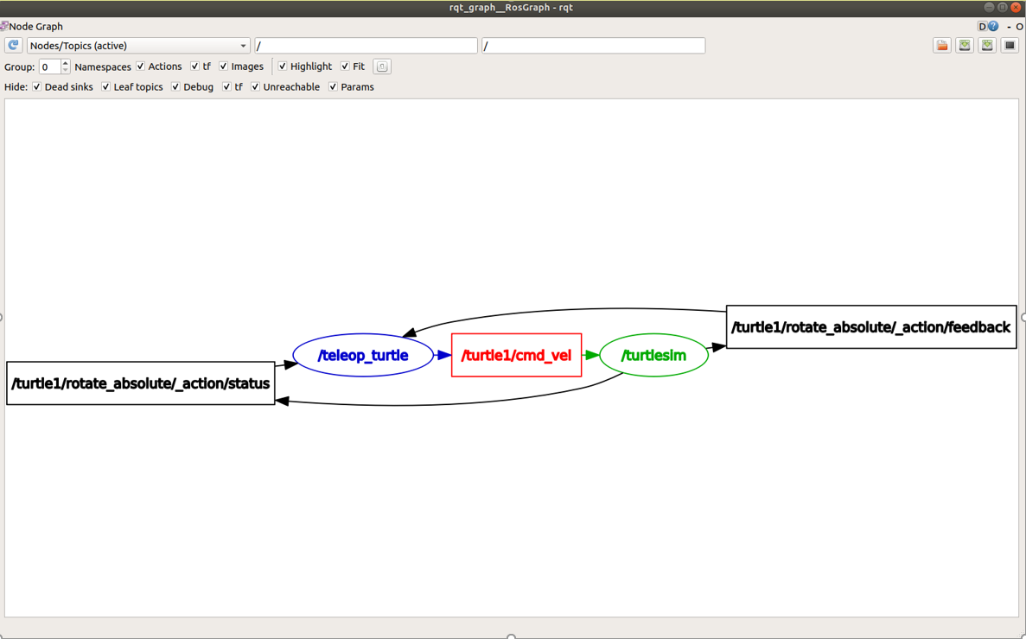
RQT
QT based ROS2 GUI Tool
Offers plugins for
Node graph monitor
Service caller type viewer
Topic publisher/listener type viewer
Image view,
Plot, etc.
rqt &
to launch default main window
ros2 run rqt_<plugin> rqt_<plugin>
Launching specific plugins

Slide 62
Activity 3: Using RQT with Turtlesim
Learn how to run rqt_graph to view node interactions in the system
Learn how to list all available topics active in the system
Learn how to see the data being published on a topic
Determine the general information of a topic, and the different publishers and subscribers of it
Discover the detailed composition of a message published in a topic.
Create a publisher in the command line and see the effects of the published message
Notes:
(30mins)

Slide 63
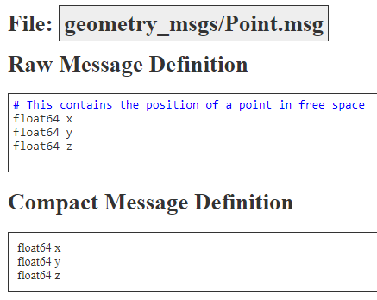
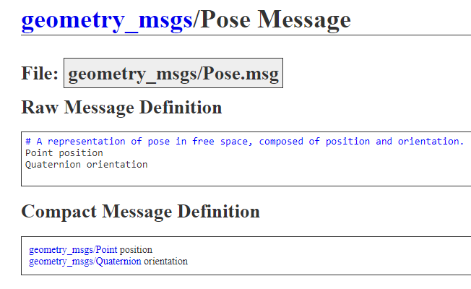
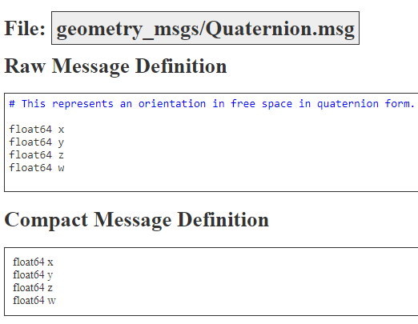
ROS2 Messages
Data structure to exchange information between components
Messages are simple text files with field type and name defined in programming language agnostic way
Notes:
https://www.vectorstock.com/royalty-free-vector/group-chat-vector-3869402

Slide 64
ROS2 Messages
Supported field types
int8, int16, int32, int64, float32, float64, string,
Variable-length array[]
Fixed-length array[C]
Bounded-length array[<=C],
Constructed from primitive data types or other ROS msgs
Notes:
https://www.vectorstock.com/royalty-free-vector/group-chat-vector-3869402

Slide 65
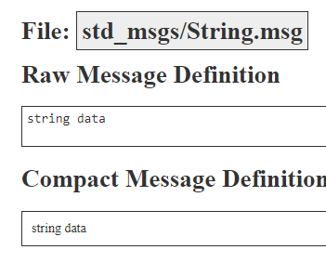
ROS2 Messages
Node_A
Node_B
Subscriber
“hello!”
/chatroom
Publisher
Callback
“A says “hello!”
self.create_publisher(String, '/chatroom', 10)
Notes:
https://www.vectorstock.com/royalty-free-vector/group-chat-vector-3869402

Slide 66
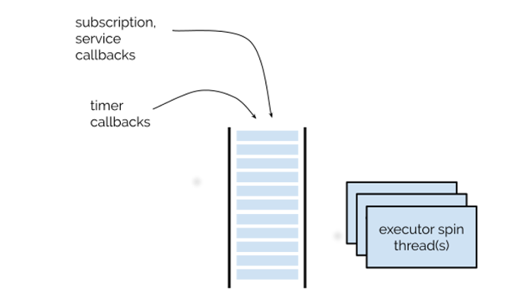
ROS2 Executor
Coordinates order and timing to execute available communication tasks
Provides spin functions (spin(), spin_once()…) for nodes that invokes callbacks
Coordinates nodes and callback groups by looking for available work, and dispatch it to one or more threads
subscription callback
timer callback
Service callback
Client responses
Coordination based on threading/concurrency scheme in implementation
Notes:
https://www.vectorstock.com/royalty-free-vector/group-chat-vector-3869402

Slide 67
ROS2 Executor
Default executor
rclpy.init(args=args) talker = Talker() rclpy.spin(talker)
Built-in executors
SingleThreadedExecutor – Runs callbacks in the thread that calls executor.spin()
MultiThreadedExecutor – Runs callbacks in a pool of threads
executor = SingleThreadedExecutor() talker = Talker()
listener = Listener()
executor.add_node(talker) executor.add_node(listener) executor.spin()
Can create custom executors as well!
Notes:
https://www.vectorstock.com/royalty-free-vector/group-chat-vector-3869402

Slide 68
Activity 4 – Create Publisher & Subscriber
Practice the Python implementation of a ROS2 Subscriber
Practice the Python implementation of a ROS2 Publisher
Practice populating a package.xml file
Practice populating a setup.py file
rosdep install --i --from-path src --rosdistro foxy -y
rosdep install --i --from-path src --rosdistro “${ROS_DISTRO}” -y

Slide 69
ROS2 Communication concepts

Slide 70
Common concepts
ROS2 Services
ROS2 Actions
ROS2 Params
ROS2 Launch files

Slide 71




ROS Services
Payment after providing a meal
Customer
Ordering a meal
Restaurant
2 Burgers please
That will be $5
Prepared
meal
Notes:
https://webstockreview.net/explore/cashier-clipart-fast-food-cashier/
https://www.visualpharm.com/free-icons/person-595b40b85ba036ed117da7ec
https://www.freepik.com/premium-vector/delicious-burger-icon-food-beverages_1808257.htm

Slide 72
ROS Services
Client
Request
Response
2 Burgers please
That will be $5
Server
Service
Node 1
Node 2
Notes:
https://webstockreview.net/explore/cashier-clipart-fast-food-cashier/
https://www.visualpharm.com/free-icons/person-595b40b85ba036ed117da7ec
https://www.freepik.com/premium-vector/delicious-burger-icon-food-beverages_1808257.htm

Slide 73
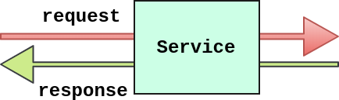
ROS Services
A mechanism for a node to send a request to another node and receive a response in return Similar to remote procedural calls that terminates quickly
Example: spawning a robot into an environment
Data structure for services defined by a pair of messages: Request and Response.
#request
int8 a
int8 b
---
#response
int8 sum
addition.srv
Request and responses are separated by this divider

Slide 74
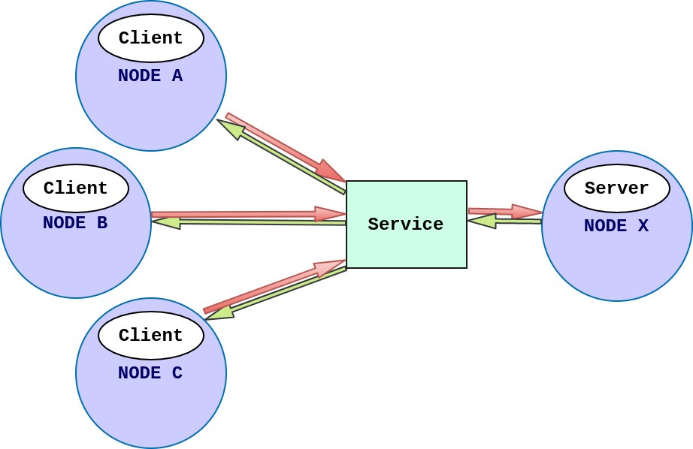
ROS Services
There can be only one service server for a ROS2 service. Multiple server clients can use the same service server.
Server decides how goals from multiple clients will be handled simultaneously.

Slide 75
Seeing a Server and Client in action!
Terminal 1
source /opt/ros/foxy/setup.bash ros2 run demo_nodes_cpp add_two_ints_server
#request
int8 a
int8 b
---
#response
int8 sum
Terminal 2
source /opt/ros/foxy/setup.bash ros2 run demo_nodes_cpp add_two_ints_client
Incoming request
Node 1
Node 2
2 , 3
AddTwoInts
(Service)
Client
5
Result of add_two_ints: 5

Slide 76
Services on command line
ros2 service list
List the services offered by servers
ros2 interface show <service_type_name>
Get more information about a service
Directly call a service:
ros2 service call <service_name> <service_type_name> "{<field1_key>: <field1_value>, <field2_key>: <field2_value>, ...}"
Example: ros2 service call /add_two_ints example_interfaces/srv/AddTwoInts "{a: 5, b: 6}"

Slide 77
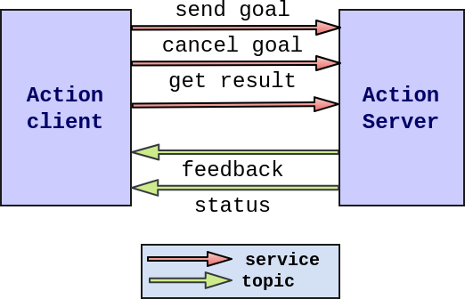
ROS Actions
Action interface Definition
Goal: What action to achieve and how to.
Feedback: Progress towards completing the action
Preempt: Able to be cancelled while executing
Result: Outcome of an action
Used for tasks that
Has longer execution times
Requires preemption
Requires regular feedback
Example. Path planning in navigation
Notes:
preemption is the act of temporarily interrupting an executing task

Slide 78
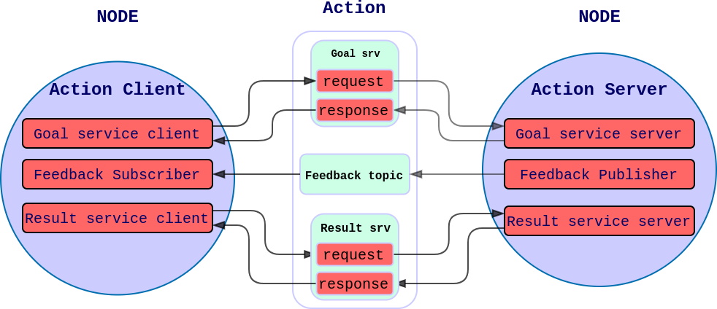
ROS Actions
Action clients send goal and result requests to action servers
Action servers execute goal and provide feedback and results to action clients
Feedback uses topics whereas Goal and Result uses services.

Slide 79
ROS Action
Data structure for Actions
Defined by a set of messages: Goal, Result and Feedback.
*.act is a file with type and name with fields separated by
# Define a goal of washing all dishes
bool heavy_duty # Spend extra time cleaning
---
# Define the result that will be published after the action execution ends.
uint32 total_dishes_cleaned
---
# Define a feedback message that will be published during action execution.
float32 percent_complete
uint32 number_dishes_cleaned
Goal
Result
Same divider as services!
Feedback
Chores.act

Slide 80
ROS Action vs Services
Actions | Services
Intended for longer running tasks | For tasks that terminated quickly
Preemptable | Not preemptable
Consists of goal, result and feedback | Consists of request and response
Provides steady feedback | Provides a single response

Slide 81
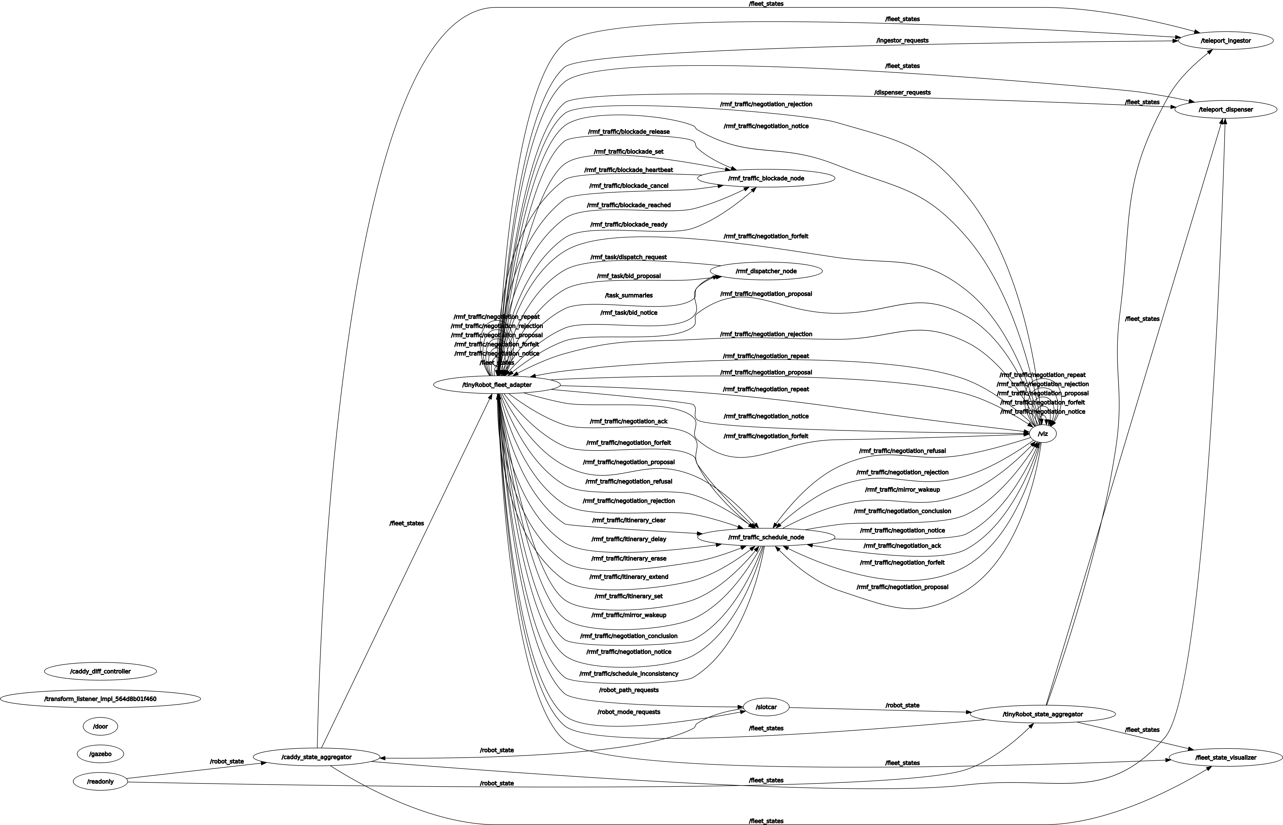
ROS2 Launch File - Motivation
ROS is a Distributed System
often 10s of nodes, plus configuration data
painful to start each node “manually”
Imagine launching all the nodes here. How many terminals would we need?

Slide 82
ROS2 Launch File
What is the purpose of the launch file?
Describes and executes the configuration of the system.
Configuration of the system includes
What program to run
Where to run them
What arguments to pass to them
Loading of parameters
Remapping topic names, parameters, etc.
Launch files simplify running complex systems with many nodes and specific configuration details.
ros2 launch <package_name> <launch_file_name>

Slide 83
ROS2 Launch File
Location of launch file
package_name
|--setup.py
|--setup.cfg
|--package.xml
|--launch
└── <launch_filename>.launch.py
Running a launch file
ros2 launch <package_name> <launch_file_name>.launch.py

Slide 84
ROS2 Launch File
Creating Launch Files
from launch import LaunchDescription
from launch_ros.actions import Node
def generate_launch_description():
ld = LaunchDescription()
node_1 = Node(
package="ros2_tutorials_py",
executable="node_1"
)
node_2 = Node(
package="ros2_tutorials_py",
executable="node_2"
)
Create an instance of LaunchDescription
Create an instance of a node in a package
Create an instance of a node in another package
ld.add_action(node_1) ld.add_action(node_2)
return ld
Add nodes to the LaunchDescription
Return the Launch Description

Slide 85
Node Composition
Deploying components in a Launch File
container = ComposableNodeContainer(
node_name=<node_name>
node_namespace=‘’,
package=‘rclcpp_components’
node_executable=‘component_container’
composable_node_descriptions=[
ComposableNode(
package=<package_name>,
node_plugin=<plugin_name>,
node_name=<node_name>),
ComposableNode(
package=<package_name>,
node_plugin=<plugin_name>,
node_name=<node_name>)
],
output=‘screen’,
)
Official ROS2 Client Package containing tools for dynamically loadable components.
Relevant Node executable for the rclcpp package
Package containing your composable node
Name of the node plugin declared
Notes:
https://docs.ros.org/en/foxy/Concepts/About-Composition.html
Using ROS2 Service APIs
Service calls
Command line tools
Launch files
Manual compositions
Running Standalone Executables
Component Manager is part of a ROS2 package that provides tools to manage dynamically loadable components.

Slide 86
ROS2 Launch
For a Python package, in “setup.py”:
...
data_files=[
('share/ament_index/resource_index/packages’,
['resource/' + package_name]),
('share/' + package_name, ['package.xml']),
(os.path.join('share', package_name, 'launch'), glob('launch/*.launch.py'))
],
...
Installing all files in config folder that contains the .launch.py filetype
For a CMake package, in “Cmakelists.txt”:
...
install(DIRECTORY
launch
DESTINATION share/${PROJECT_NAME}
)
...
Installing the entire launch folder of the package
References for ROS2 Params

Slide 87
Activity 5 : Creating a launch file for turtlesim
Create a launch file that combines the nodes that we have been individually launching in multiple terminals
Notes:
(15 mins)

Slide 88
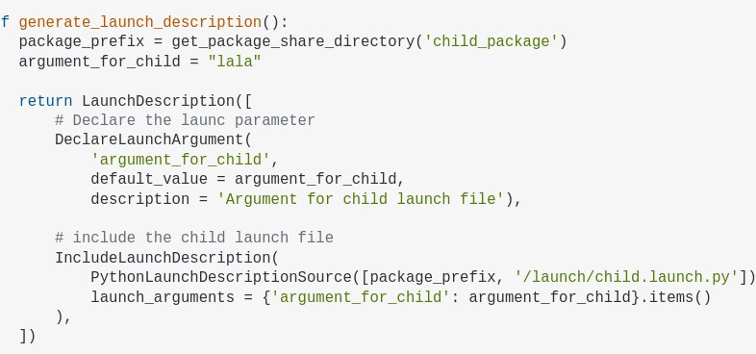
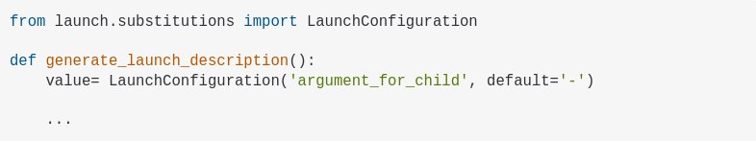
Referencing other launch files
i
Parent launch file
Child launch file

Slide 89
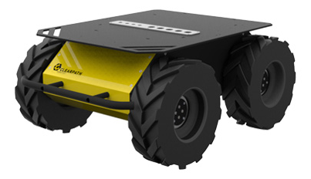
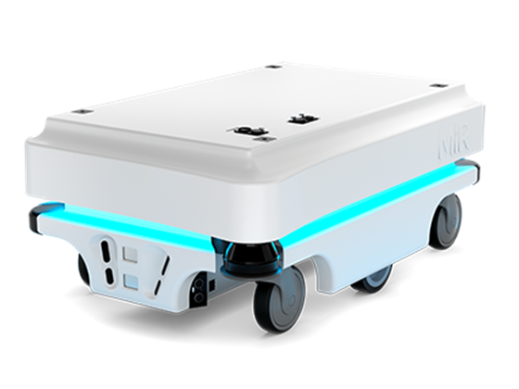
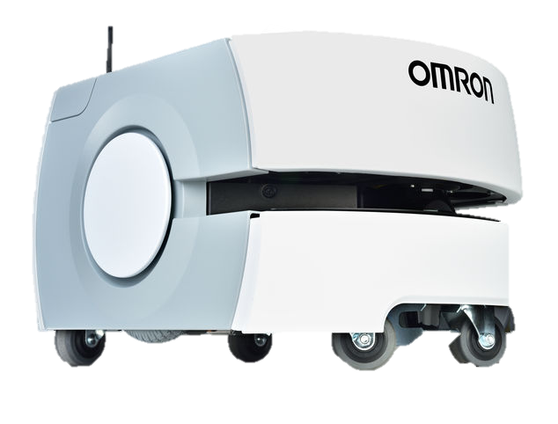
ROS2 Params
Wheel Radius: 15cm
Platform length: 25cm
Platform width: 10cm
Navigation Package
Wheel Radius: 5cm
Platform length: 25cm
Platform width: 10cm
?
Wheel Radius: 7cm
Platform length: 15cm
Platform width: 12cm
Notes:
https://clearpathrobotics.com/husky-unmanned-ground-vehicle-robot/
https://www.mobile-industrial-robots.com/en/solutions/robots/mir100/

Slide 90
ROS2 Params
A nice way to set parameters at run time, without having to recompile the code for the node. These parameters can be dynamically reconfigured using ROS2 services.
Declaring parameters in script
self.declare_parameter(‘wheel_diameter’)
self.declare_parameter(agv_name’’)
self.declare_parameters(
namespace='',
parameters=[
(‘agv_name', None),
(‘wheel_diameter', None),
(‘platform_length',None),
(‘platform_width', None)
])
Declaring Parameters individually
Declaring Parameters as a group with default values
Setting the ros2 params in command line.
Setting parameters in command line at runtime
ros2 run fleet_package fleet_navigation --ros-args -p agv_name:=“agv" -p wheel_diameter:=15
Notes:
param_str = self.get_parameter(‘agv_name')
param_int = self.get_parameter(‘wheel_diameter ')
self.get_logger().info("str: %s, int: %s" % (str(param_str.value), str(param_int.value)))

Slide 91
ROS2 Params
YAML for ROS2 params
Managing parameters when number of params increases becomes complex.
Adding them in command line is not an option
YAML is more human readable and Great for loading a configuration file at run time
package_name
|--config
└── params.yaml
|--launch
└── test_params.launch.py
|--package.xml
node_name:
ros_parameters:
agv_name: “agv”
wheel_diameter: 15
platform_length: 12
platform_width: 13

Slide 92
ROS2 Params
From launch file
def generate_launch_description():
ld = LaunchDescription()
config = os.path.join(
get_package_share_directory('package_name'),
'config', 'params.yaml'
)
node=Node(
package = ‘package_name',
name = ‘node_name',
executable = 'test_yaml_params',
parameters = [config]
)
ld.add_action(node)
return ld
Get the filepath of the config file
Load the filepath as the parameter file
From command line
ros2 run pkg_name node_name --ros-args --params-file .~/package_name/config/params.yaml

Slide 93
ROS2 Params
For a Python package, in “setup.py”:
...
data_files=[
('share/ament_index/resource_index/packages’,
['resource/' + package_name]),
('share/' + package_name, ['package.xml']),
(os.path.join('share', package_name, 'config'), glob('config/*.yaml'))
],
...
Installing all files in config folder that contains the .yaml filetype
For a CMake package, in “Cmakelists.txt”:
...
install(DIRECTORY
config
DESTINATION share/${PROJECT_NAME}
)
...
Installing the entire config folder of the package
References for ROS2 Params

Slide 94
ROS2 Additional tools

Slide 95
Aliasing
Aliases are custom defined abbreviations for commands.
File that executes when a user logs in
gedit ~/.bashrc
Open .bashrc script file
Command string
Actual command to be executed
alias foxy=‘source /opt/ros/foxy/setup.bash’
Add your alias
source ~/.bashrc
Source the setup file to register the changes
Now we can just type the word foxy to source the ros2 version!

Slide 96
Still too tedious?
echo "source /opt/ros/foxy/setup.bash" >> ~/.bashrc
Now you don’t need to source your ROS distribution anymore!

Slide 97

ros2bag
Command line tool for recording data published on topics in your system.
Saved in a database
Can be replayed to reproduce results
Good way to share the work, and recreate it
publisher
Subscriber
/topic_1
Subscriber
/topic_1

Slide 98
ros2bag on command line
ros2 bag record <topic_name>
Record a ros2bag from a certain topic
ros2 bag record -o <bag_name> <topic_name>
Record a ros2bag and name it
ros2 bag info <bag_file_name>
Get the information of a ros2bag and name it
ros2 bag play <bag_file_name>
Play the ros2bag

Slide 99
ros1_bridge
A package that provides a network bridge which enables the exchange of messages between ROS 1 and ROS 2.
Topics
Topics
ROS1
ros1_bridge
ROS2
Services
Services
https://github.com/ros2/ros1_bridge

Slide 100
ros2doctor
Identify issues in the system
Analyse ROS2 installation as well as running systems, show reports
Look for potential issues in a running ROS2 System
ros2 doctor
Conduct checks over all your setup modules and return warnings and errors.
ros2 doctor --report
Full Technical report of the installation
https://github.com/ros2/ros2cli/tree/foxy/ros2doctor

Slide 101
Further resources

Slide 102
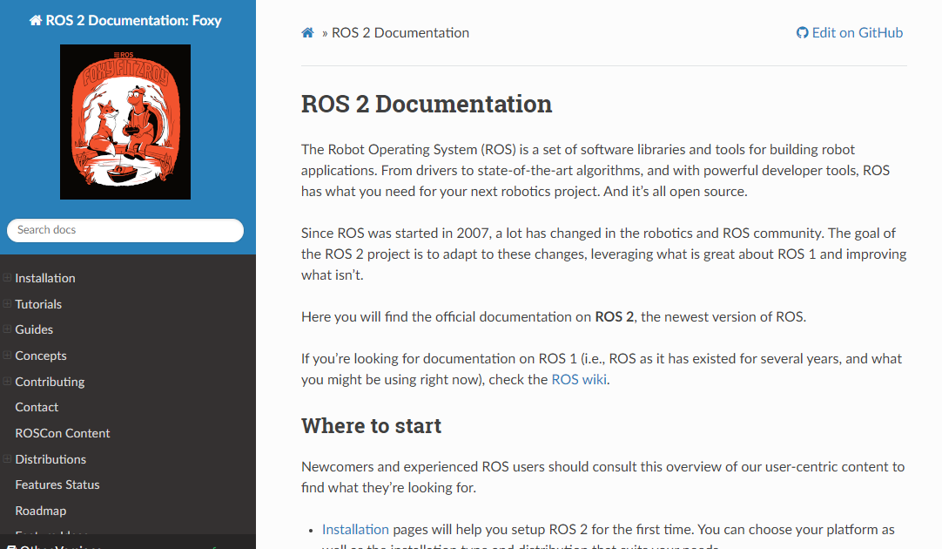
ROS2 Documentation
https://docs.ros.org/en/foxy/index.html
Provides more detailed elaboration of ROS2 concepts
Provides more tutorials to apply more complex concepts learnt (Node composition, Servers, Actions)

Slide 103
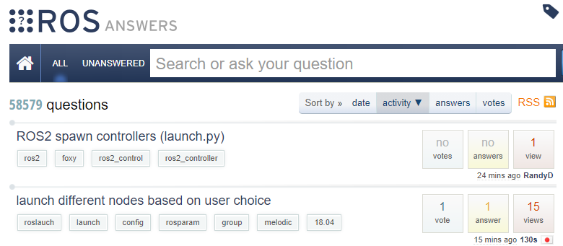
ROS Answers
https://answers.ros.org/questions/
“stack overflow” type question boards
Very useful to find solutions for commonly faced ROS issues

Slide 104
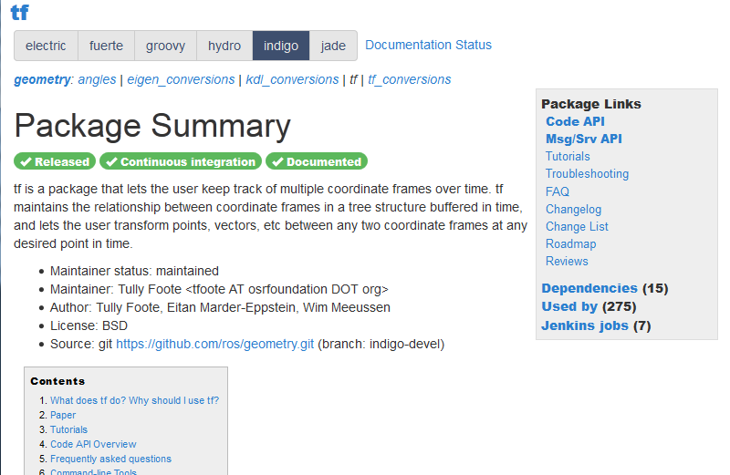
ROS Wiki
http://wiki.ros.org/Documentation
In depth description of specific ROS packages
Quality definitions for ROS packages
Includes relevant non-ROS related concepts (hardware, books/papers)
Most packages are ROS1 packages, but concepts are still relevant

Slide 105
Final Task
Main Objective: Create a package that shows your webcam display.

Slide 106
Final Task – Pt1
Do a Debian installation of the following libraries
ros-foxy-v4l2-camera
libopencv-dev
python3-opencv
source /opt/ros/foxy/setup.bash
sudo apt-get install ros-foxy-v4l2-camera libopencv-dev python3-opencv

Slide 107
Final Task – Pt1
2. Run the camera node with executable v4l2_camera_node in the package v4l2_camera
ros2 run v4l2_camera v4l2_camera_node

Slide 108
Final Task – Pt1
3. Create a workspace with a python package named camera_test and node name camera_viewer
source /opt/ros/foxy/setup.bash
mkdir –p ~/final_ws/src
cd final_ws/src
ros2 pkg create --build-type ament_python --node-name camera_viewer camera_test

Slide 109
Final Task – Pt1
Create a subscriber that subscribes to the topic published by the camera node representing the raw image
Use a ros2 topic command to find out the topics being published when you run the camera node
ros2 run v4l2_camera v4l2_camera_node
ros2 topic list

Slide 110
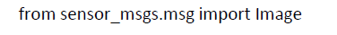
Final Task – Pt1
Create a subscriber that subscribes to the topic published by the camera node representing the raw image
Use a ros2 topic command to find out the message type of the topic being published (You can omit the sensor_msgs/msg/ part of the message type for this parameter)
ros2 run v4l2_camera v4l2_camera_node
sensor_msgs/msg/Image
ros2 topic info /image_raw

Slide 111
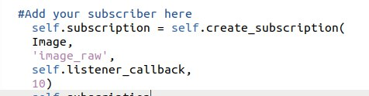
Final Task – Pt1
5. Create a subscriber that subscribes to the topic published by the camera node representing the raw image

Slide 112
Final Task – Pt1
6. Build your workspace
7. Source your workspace
8. Run the camera node and the camera viewer node. You should now see a popup window displaying your webcam output
cd ~/final_ws
colcon build
source install/setup.bash
source install/setup.bash
ros2 run camera_test camera_viewer
ros2 run v4l2_camera v4l2_camera_node
Terminal 1
Terminal 2

Slide 113
Final Task Part 2
Create a launch file to combine the following 2 commands
ros2 run camera_test camera_viewer
ros2 run v4l2_camera v4l2_camera_node
from setuptools import setup
import os
from glob import glob
…
…
In setup.py

Slide 114
Final Task Part 2
Create a launch folder in the camera test package folder
Create a launch file, camera_display.launch.py
cd ~/dev_ws/src/py_pubsub
mkdir launch
cd launch
gedit camera_display.launch.py

Slide 115
Final Task Part 2
3. Copy the following in the launch file
from launch import LaunchDescription
from launch_ros.actions import Node
def generate_launch_description():
ld = LaunchDescription()
#TODO#complete your code to call both v4l2_camera_node and py_pubsub listener here#
return ld

Slide 116
Final Task Part 2
4. Create two different nodes
The first node will be from the camera_test package with executable camera_viewer.
The second node will be from the v4l2_camera package with executable v4l2_camera_node.
node_1 = Node(
package=“camera_test",
executable=“camera_viewer"
)
node_2 = Node(
package=“v4l2_camera",
executable=“v4l2_camera_node"
)

Slide 117
Final Task Part 2
5. Make sure to add each node to the LaunchDescription instance with the add_action function
ld.add_action(node_1)
ld.add_action(node_2)

Slide 118
Edit setup.py
Make sure to add the launch.py file into your setup.py file
from setuptools import setup
import os
from glob import glob
…
…
data_files=[
('share/ament_index/resource_index/packages’,
['resource/' + package_name]),
('share/' + package_name, ['package.xml’]),
(os.path.join('share', package_name, 'launch'), glob('launch/*.launch.py’))
],

Slide 119
Final Task Part 2
6. Build the workspace
7. Source the workspace
8. Launch the launch file. There will be the popup with your webcam video playing.
cd ~/final_ws
colcon build
source install/setup.bash
ros2 launch camera_test camera_display.launch.py

Slide 120
Summary
High level understanding of what ROS2 is
Understanding the main differences between ROS1 and ROS2
Understand the general components in a ROS2 filesystem
General Concept of ROS2 nodes
ROS2 node communication methods
Additional useful tools in ROS2

